Slide 1
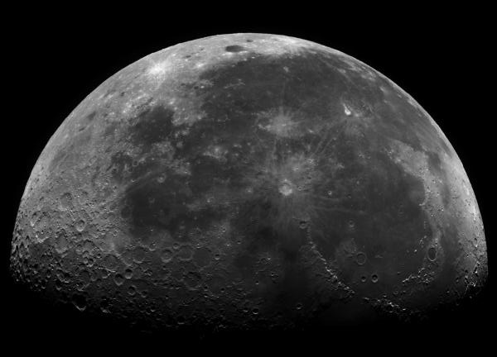
Analysing Lunar Craters
Using data from the Liverpool Telescope

Slide 2
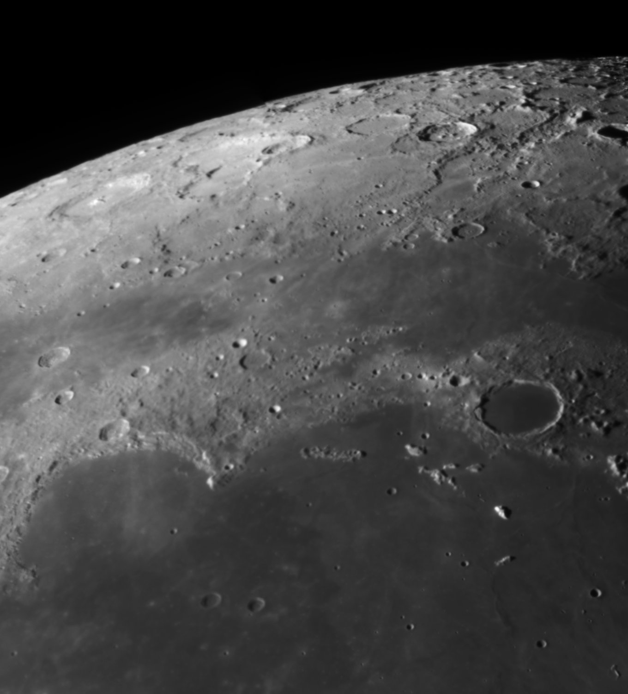
The Project
We will look in detail at images of the Moon to determine whether the density, size and appearance of craters varies across the lunar surface.

Slide 3
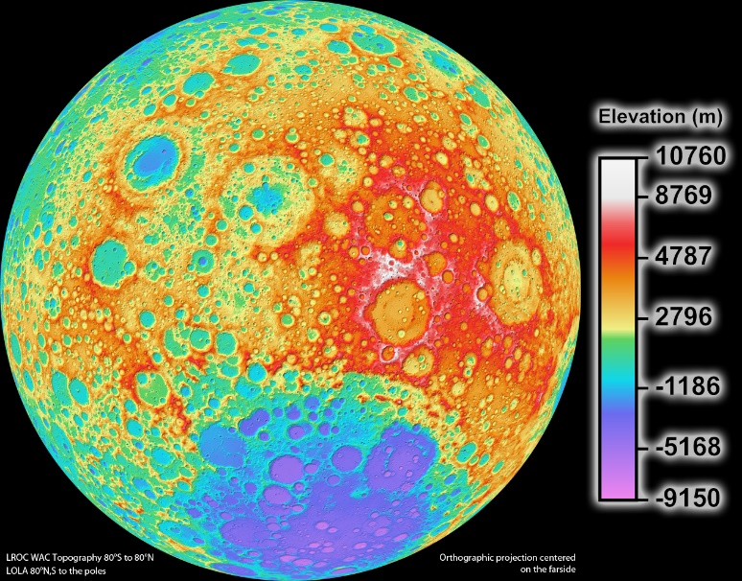
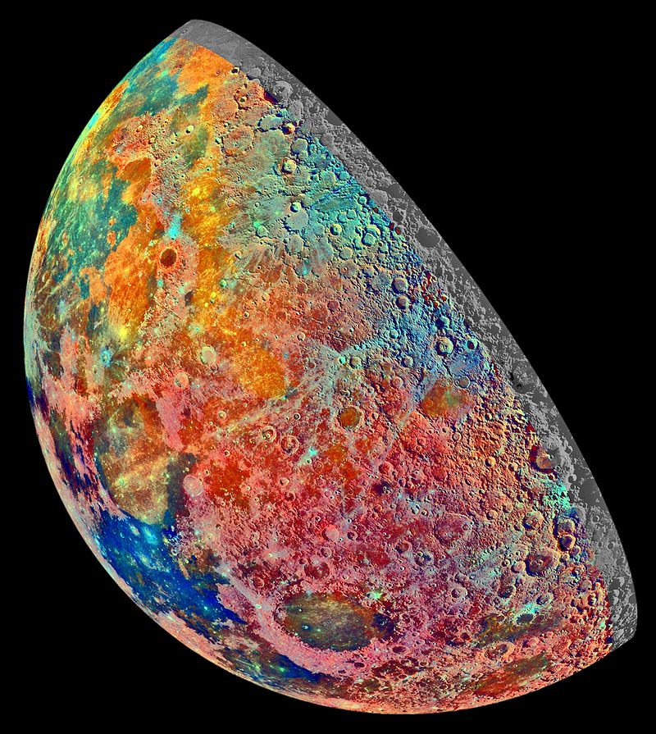
The Project - Discussion
Whilst there are more accurate ways of measuring the size, density and brightness of objects on the Moon’s surface, our activity will provide insight into the creation of features on the lunar surface.
Bright pink – highlands
Blue to orange – volcanic lava flows
Dark blue – titanium rich ‘sea’
Green to orange – ‘seas’
Light blue – thin mineral rich soil
NASA
Radar map of the Moon taken by the NASA Lunar Reconnaissance Orbiter showing the height of features on the surface (topology) – the high ground is white and red, and the low ground purple.
NASA
Geological map of the Moon from the Galileo Spacecraft.

Slide 4
Background
The Moon is our nearest neighbour in space, and the only celestial body on which we can see surface detail without the need for a telescope.
Look more closely, however, and it is soon apparent that the lunar surface is not smooth, but hosts a variety of dark and bright regions, mountain ranges and thousands upon thousands of craters.
In this exercise we will examine image data of the Moon taken by the Liverpool Telescope, and use it to try and quantify those surface changes.

Slide 5
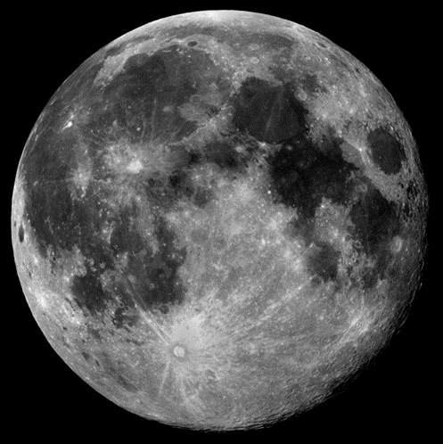
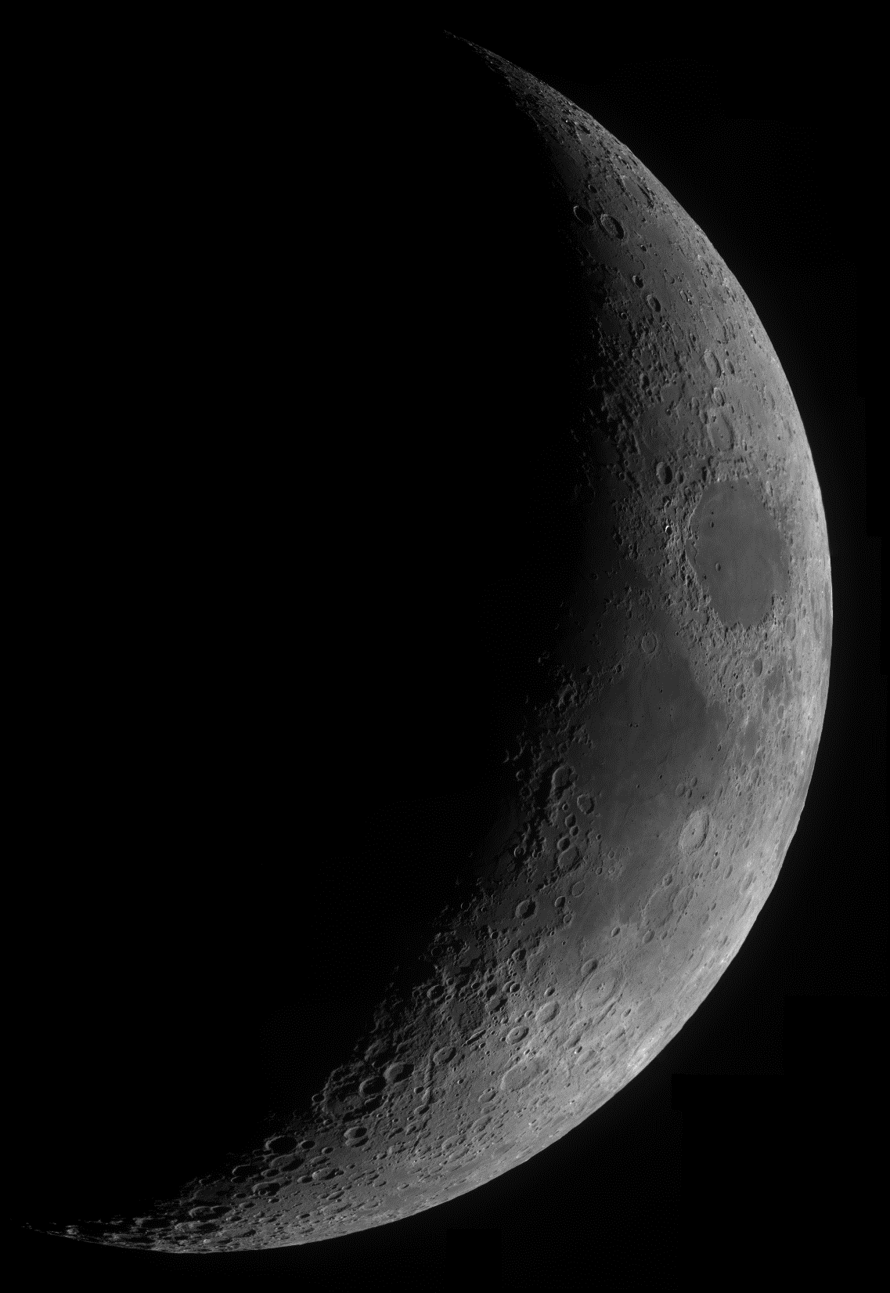
Moon Phases
When the phase of the Moon is full, the Sun is right behind us and sunlight falls straight down onto the lunar surface. As a result, it can be hard to determine the exact nature of crater features – especially in bright regions.
However, when the Moon is close to first quarter or last quarter phase, it is often easier to spot the extent of craters, due to the shadows that are cast. In a sense, shadows can make the surface of an object appear more 3 dimensional.

Slide 6
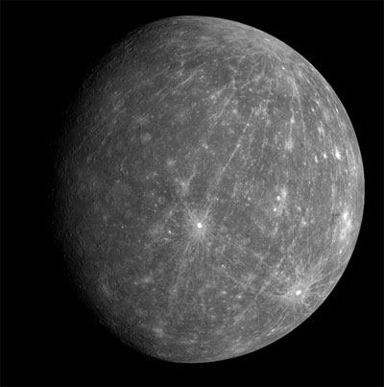
Prediction
If we were to examine an image of a small planet, such as Mercury, we might expect that the surface of similar rocky objects would have a roughly even spread of craters.
After all, the asteroids that created the larger craters we see would have been fairly evenly spread throughout the early Solar System, when the majority of impacts took place.
The planet Mercury © NASA

Slide 7
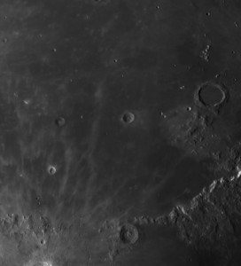
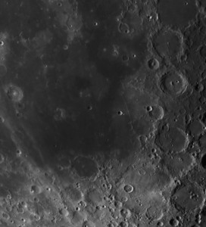
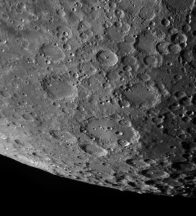
The Task – Surface Analysis
Out task is to select around 10 regions of the Moon to investigate in small groups. By taking a few measurements and recording what we see, we can start to quantify the differences between the chosen areas.

Slide 8
Assembling the Moonsaic
Now that we know the task, we need to assemble a large mosaic of the 20 Moon images so that we can select a few regions of the lunar surface to explore.
You can print these images out and stick them together – like a jigsaw puzzle. Note that each image overlaps slightly, which will help to match the edges and glue them securely.

Slide 9
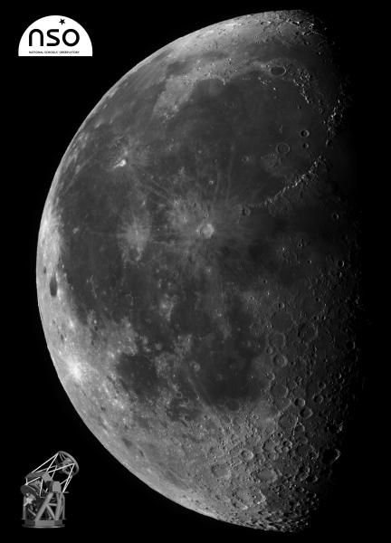
Moonsaic
This is how your mosaic image of the Moon should look when finished:
Have fun!

Slide 10
Making your Measurements
Once the Moonsaic is complete, get into teams of 3 and choose one region (or image panels) to.
The first measurement we can make is to count the number of craters above a certain size in the section. Don’t choose a size that is too small or you may be there all day, but make sure you all agree on the same minimum width.
Complete the table below for your section:
Make sure you number each of the craters on the Moonsaic, and ensure that everyone is using the same units when measuring.
Moon Region | Number of Craters | Size of Largest Crater (cm) | Description of Region
Section 1

Slide 11
Results
Moon Region | Number of Craters | Size of Largest Crater (mm)
Section 1
Section 2
Section 3
Section 4
Section 5
Section 6
Section 7
Section 8
Section 9
Section 10

Slide 12
Calibrating the Result
We now need to calibrate our results, so that we convert these sizes to the actual size on the Moon’s surface (in kilometres).
To do this we need to measure the radius of the Moon on your poster with a ruler = _________________ mm.
We also need to know that the Radius of the actual Moon = 1738 km
To work out the crater width on the Moon apply this equation:
$$\frac{Crater Width on Moon (km)}{Moon Radius (km)}= \frac{Crater Width on poster (cm)}{Moon Radius on poster (cm)}$$

Slide 13
Describing the Region
How would you describe the region you’ve been given?
Is it entirely covered in craters or are there any flat regions.
What would a percentage estimate of how much of the region (i.e. the area) is cratered be?
Are there any mountain ranges visible and if so, how far do they stretch?
Are there any unusual features to be seen?

Slide 14
Discussion
Our initial prediction suggested that the lunar surface may have an even covering of asteroid impacts or craters – how does that prediction fit with your results?
Of course, the method we have used will only give us a rough estimate for a limited selection of the Moon’s surface. Can you think of any areas of the process where errors may have crept into your measurements?
Can you think of other ways in which we could identify the differences between different regions of the Moon?
Notes:
The results shouldn’t show an even distribution of craters on the surface – this is for the following reasons:
Craters with sharper edges were formed more recently – those which hit the Moon when it still had erupting volcanoes may have been covered in lava and hence not be seen now. The Earth also protects the Moon from impacts of asteroids – the Earth and Moon are tidally locked i.e. it rotates at the same rate as it takes to complete an orbit of the Earth – meaning we always see the same side. If you look at the far side (or dark side) of the Moon it is covered in many, many more craters as the Earth hasn’t shielded it from impacts. The Moon also has mountain ranges (or highlands) created by the collision of objects with the surface leaving deep craters – these are the lighter parts of the Moon’s surface. The darker regions are ‘seas’ – created by vast lava fields from the volcanoes on the surface – around 1-3 billion years ago. Craters on the Moon also survive longer than on Earth as there is no weather or erosion on the Moon.

Slide 15
Extensions:
Now that you have measured the number of large craters in each section, you may want to record the size of all the craters you labelled, to see if the average size changes from region to region. Would you expect a difference?
You may also want to explore the process of how mountains are created in the centre of craters following an impact.
Look at the Moonsaic again, and then try to work out whether it was taken at first or last quarter phase. Try to establish in which direction the Moon orbits the Earth.

