Slide 1
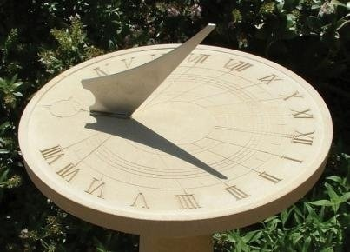
Sundials

Slide 2
Learning Objectives
To understand how a sundial works with the Sun
To understand how a sundial can be used to tell the time.

Slide 3
Key Questions
Q: What gives us the light we need to see?
Q: What causes a shadow?
Q: What happens to the shadow if the light source moves?

Slide 4
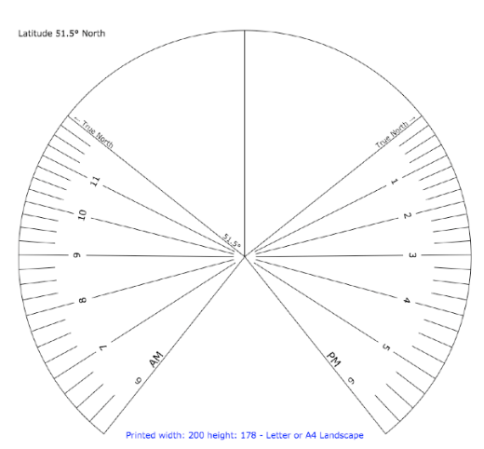
Making a Sundial
Cut around the outer edge of the sundial
Fold the centre vertical line up and the two ‘True North’ lines down to create a triangle. This is called the Gnomon.
Glue inside the triangle to ensure it keeps its shape
Take your sundial outside and point it north

Slide 5
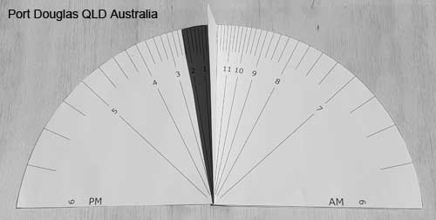
What A Good One Looks Like

Slide 6
Plenary
Q: Why does the sundial create a shadow?
Q: Why does that shadow move throughout the day?

